Slide 1
Solution to Project 01

Slide 2
Real-world tips
Two sets of skills are valued in the business world
Ability to complete assigned tasks
Ability to think logically and independently
This project was designed to provide practice for both sets of skills

Slide 3
Real-world tips
Two sets of skills are valued in the business world
Ability to complete assigned tasks
Ability to think logically and independently
This project was designed to provide practice for both sets of skills

Slide 4
Assigned tasks
01 | % of months return_{FFY} > return_{S&P500} | 45.58%
02 | CAGR for FFY | 10.56%
03 | IQR on monthly returns for FFY | 0.98%
04 | % of FFY monthly returns < 0 | 7.44%
05 | 99% of 12-month returns for FFY > ___ | 5.52%
06 | Sharpe ratio for FFY (monthly data) | 0.573 not 0.573%
07 | Expected % for return_{FFY} > return_{risk-free} | 71.67%
08 | Range for the 100 averages | 3.06%
09 | correl(return_{FFY},return_{S&P500}) | 0.319
10 | % of FFY returns > 0.0% and < 0.5% | 29.77%

Slide 5
(Demonstration in Excel)

Slide 6
Real-world tips
Two sets of skills are valued in the business world
Ability to complete assigned tasks
Ability to think logically and independently
This project was designed to provide practice for both sets of skills

Slide 7
Real-world tips
Two sets of skills are valued in the business world
Ability to complete assigned tasks
Ability to think logically
This project was designed to provide practice for both sets of skills

Slide 8
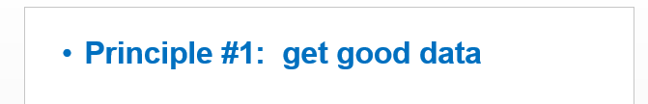
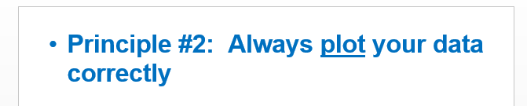
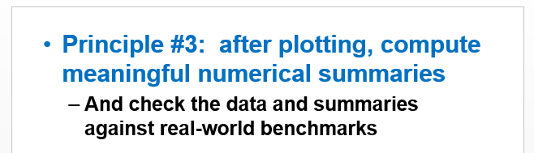
GSBA 545 lessons
From Lecture 1:

Slide 9
Some considerations for Project 1:
Did you make the most of available data?
Did you plot your data?
Did you compare your results to real-world benchmarks?

Slide 10
Some considerations for Project 1:
Did you make the most of available data?
Did you plot your data?
Did you compare your results to real-world benchmarks?

Slide 11
Data were available for 100 large-cap stocks as well as for FFY …
Did you compute metrics (percentage of positive returns, average, SD, Sharpe ratios) for the 100 companies?
Did you plot your data to see how FFY compared?

Slide 12
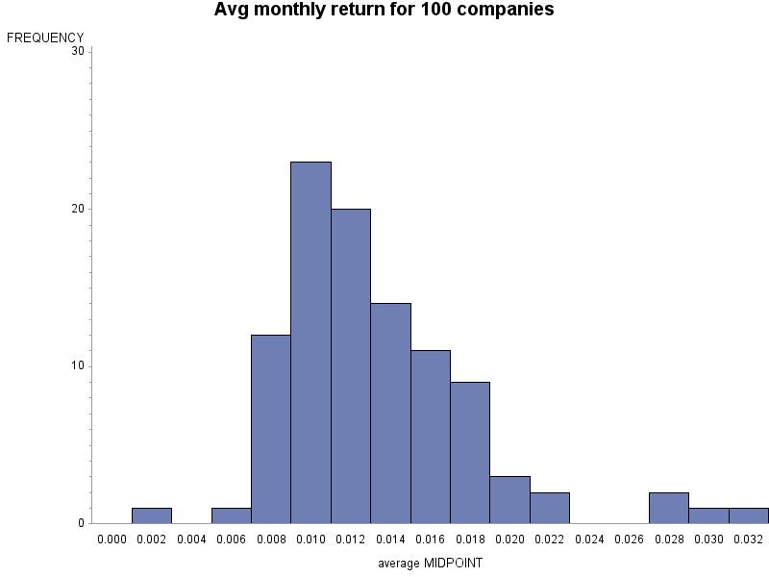
Average monthly return for 100 large cap companies
FFY

Slide 13
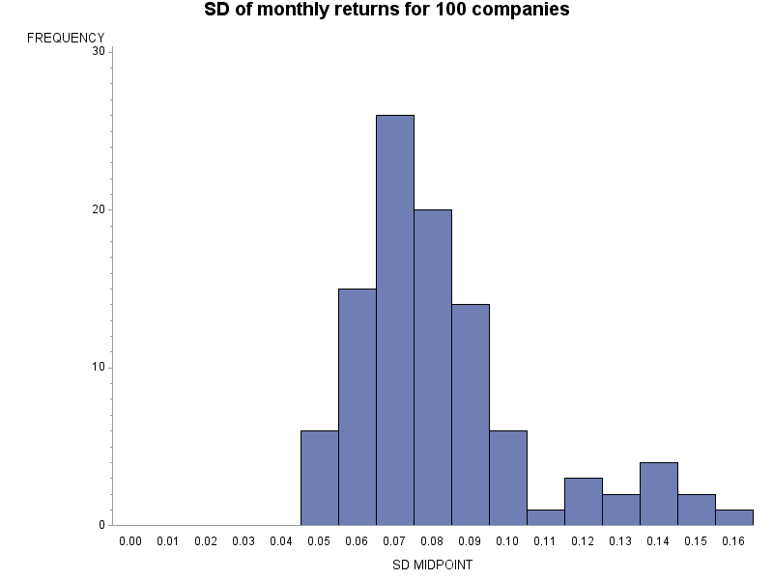
SD of monthly return for 100 large cap companies
S&P 500
FFY

Slide 14
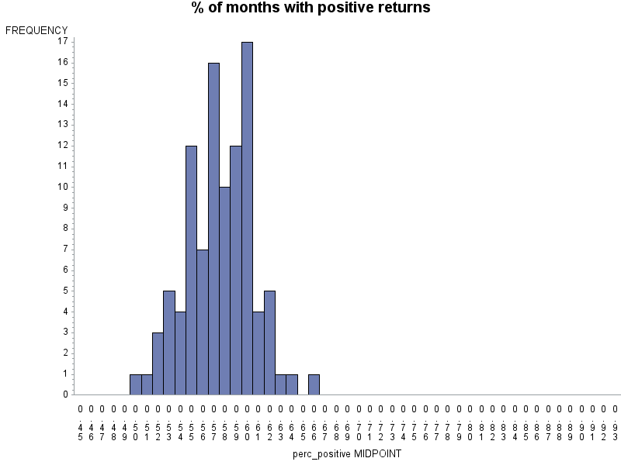
% of months w/ positive return
S&P 500
FFY

Slide 15
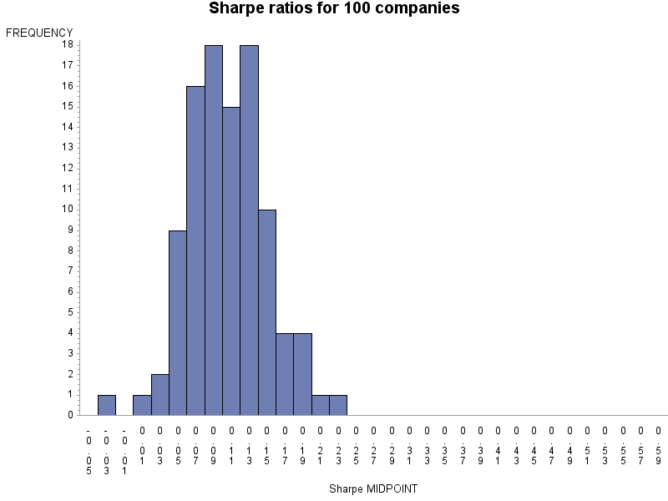
Sharpe ratios for 100 large cap companies
FFY

Slide 16
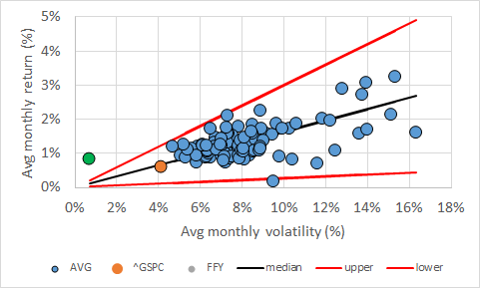

Return v. risk plot
Assumption: return = k * SD
For 100 companies, average of “return / SD” = 0.1637, SD = 0.04545
Technical note: this is a plot for equities, does not include risk-free

Slide 17
Return v. risk plot
For FFY, SD = 0.0071, return = 0.0084 → k_{FFY} = 0.0084 / 0.0071 = 1.188
Z_{FFY} = (1.188 – 0.1637) / 0.04545 = 22.5[!]
FFY

Slide 18
Summary of FFY v. 100 companies
Avg return … 0.97 SD’s below avg
SD of returns … 3.17 SD’s below avg
% positive … 11.7 SD’s above avg
Sharpe ratio … 10.8 SD’s above avg
Return v. risk … 22.5 SD’s above what would be predicted

Slide 19
Some considerations for Project 1:
Did you make the most of available data?
Did you plot your data?
Did you compare your results to real-world benchmarks?

Slide 20
Did you notice …
Does it make SENSE that a two-stock portfolio (chosen from just 13) would have a smaller standard deviation than a portfolio based on 500 stocks?
Does it make SENSE that FFY would lose money so rarely versus other stocks?
Does it make SENSE that a two-stock fund could so consistently beat the market?

Slide 21
How to invest?
Diversification reduces risk … one totally acceptable answer is to invest in S&P500
Some created portfolios using Excel’s “solver”, but this wasn’t necessary
Another totally acceptable answer is to minimize risk; i.e., T-bonds
It doesn’t make sense to BORROW money to put into T-bonds, since the return on T-bonds will be less than the interest rate
Other investments provide varying returns

Slide 22
Example of grades
Answer 10 numerical 5 questions correctly
Make case that FFY is “too 5 good to be true” → Strong Sell
Invest in S&P500 and/or T-bonds 5.1
15.1 out of 15.0

Slide 23
Concluding thoughts

Slide 24
GSBA 545 lessons
Recall Lecture 1:

Slide 25
GSBA 545 lessons
One lesson for GSBA 545, Data-based Decision Making:
Use data to make decisions!
More data may be available than you realize: make the most of all information
Always plot your data
Think about whether data makes sense: compare results to real-world metrics

Slide 26
Closing thoughts
Making decisions in the business world is difficult … do your best
Three big lessons from GSBA 545:
Lesson #1: if a deal seems too good to be true, maybe it is … be careful
Lesson #2: ( … saved for later …)
Lesson #3: ( … saved for later …)

